Slide 1
Cost of Production
A quick revision of concepts-inflexibility of short run curve-Long run cost curve- economies of scales v/s returns to scale-economies of scale and economies of scope.

Slide 2
Cost of production: A quick revision
Opportunity cost: Cost of next best alternative foregone
Sunk cost: Expenditure already made and can’t be recovered.
Total cost
Fixed cost- doesn’t vary as output varies
Variable cost- cost that varies as output varies
Marginal cost- incremental cost
Expansion path- describes the combinations of labor and capital that the firm will choose to minimize costs at each output level

Slide 3
Long Run Cost curves
Difference between short run and long run cost curves:
In short run the FC is completely outside the control of firm.
In long run, there are no fixed costs.
Both are U shaped
In the long run, the firm’s planning horizon is long enough to allow for a change in plant size. This added flexibility allows the firm to produce at a lower average cost than in the short run. To see why, we might compare the situation in which capital and labor are both flexible to the case in which capital is fixed in the short run.

Slide 4
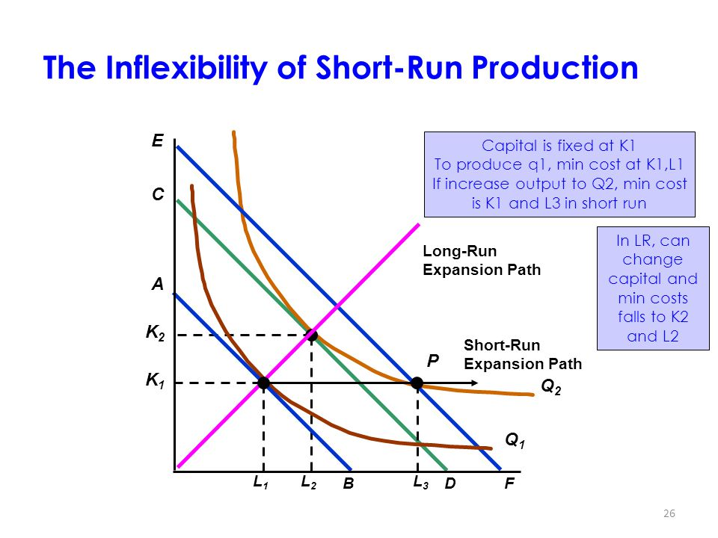
Inflexibility of short Run production

Slide 5
Why inflexibility?
Because the firm is unable to substitute relatively inexpensive capital for more costly labor when it expands production

Slide 6
Long Run Average Cost [LRAC]
Curve relating average cost of production to output when all inputs, including capital, are variable.
The most important determinant of the shape of the long-run average and marginal cost curves is the relationship between the scale of the firm’s operation and the inputs that are required to minimize its costs.

Slide 7
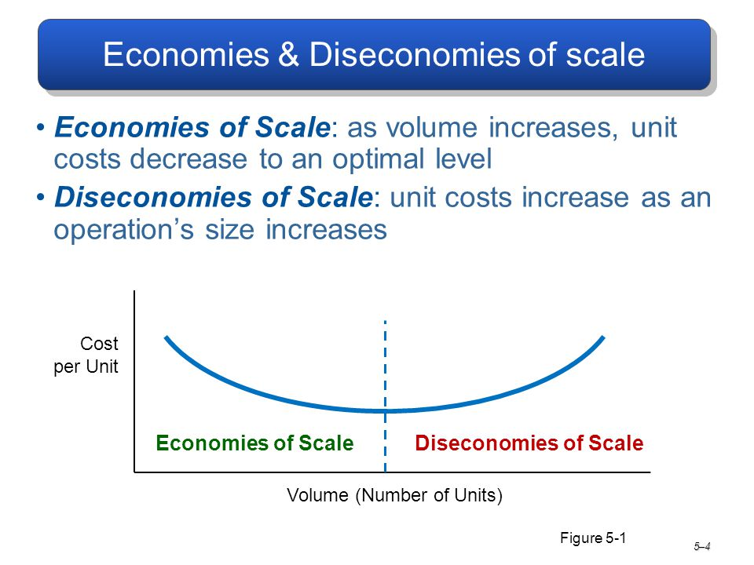

Slide 8
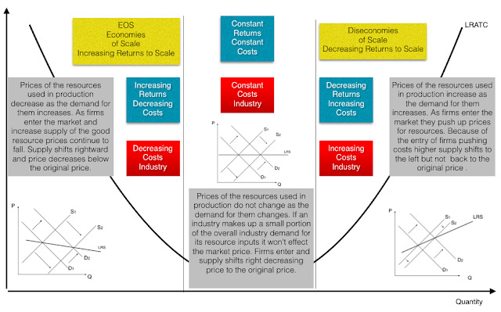

Slide 9
Why LAC/LRAC curve is U shaped?
U shape is the result of operation of returns to scale, that is firm experiences increasing returns to scale (diminishing cost) in the beginning followed by constant returns to scale and then by diminishing returns to scale (increasing cost).
LAC first declines due to economies of scales and then rises due to diseconomies of scale.

Slide 10
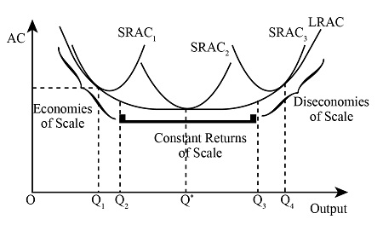

Slide 11
Difference between returns to scale and economies of scale
returns to scale: which inputs are used in constant proportions as output is increased.
economies of scale : where input proportions are variable

Slide 12
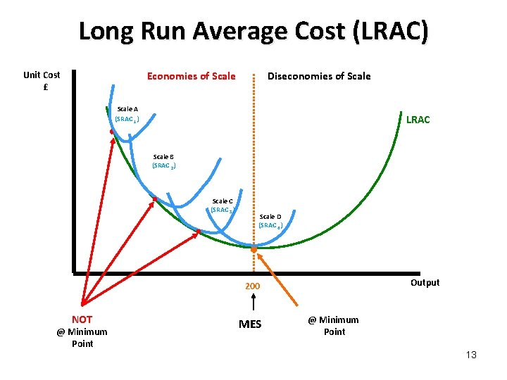
Envelope curve

Slide 13
Envelope curve
The LRAC curve is an “envelope” containing all possible short-run cost curves. Each average total cost (ATC) curve represents a manufacturing scale where the only way to increase output is to hire more workers. It is for this reason that the ATC curve lies above the LRAC curve except at one point of tangency. The point of tangency is the cost minimizing point for that level of output.
The short-run ATC curves represent different scales of plant that cannot be changed in the short run. They are all above the LRAC because firms have less flexibility in the short run and costs are higher. Each tangency point
is the cost-minimizing point for that level of output.

Slide 14
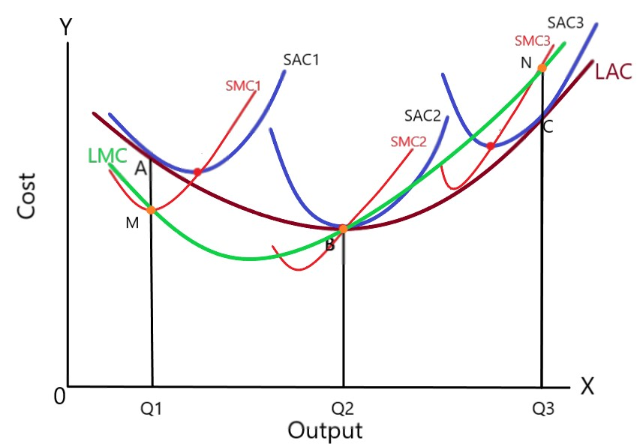

Slide 15
Economies and diseconomies of scope
Economies of scope:
Situation in which joint output of a single firm is greater than output that could be achieved by two different firms when each produces a single product.
Diseconomies of scope : Situation in which joint output of a single firm is less than could be achieved by separate firms when each produces a single product.

Slide 16
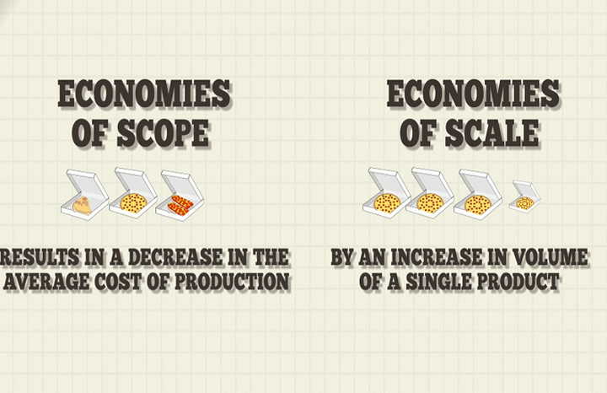

Slide 17
Externalities & Market failure
Market failure occurs when price mechanism fails to allocate scarce resources efficiently or when the operation of free market forces leads to net social welfare loss.
Free market equilibrium quantity > or < Socially Optimum Quantity.
Ways Free Market fails:
Externalities
Public good
Information failure
Monopoly power in markets

Slide 18
Externalities:
An externality is a cost or benefit caused by a producer that is not financially incurred or received by that producer
Negative
Externality
positive

Slide 19
Production Externality: When production of a good creates spill over benefits or costs for a third party Eg. Air pollution
Consumption Externality: When consumption of a good creates spill over benefits or costs for a third party Eg. Ground water extraction for industry, Alcohol etc.
Public goods: They are non-rivalrous, non excludable goods which are not provided by free market. It causes a "free-rider problem”. An individual underreports his/her demand for a good but gets benefits from it once it’s available.
Common access resources: Resources that nobody owns but anybody can exploit like clean air, waterbody etc.

Slide 20
Asymmetric Information: When the buyer and seller of a good has different levels of information about the good. Eg: difference in quality, used cars
Monopoly power: When a single firm dominates the market they tend to produce less than socially optimum level and price would be higher than that would be charged in competitive market.

Slide 21
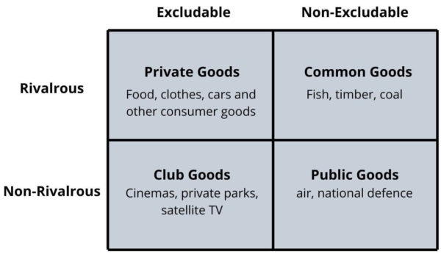

Slide 22
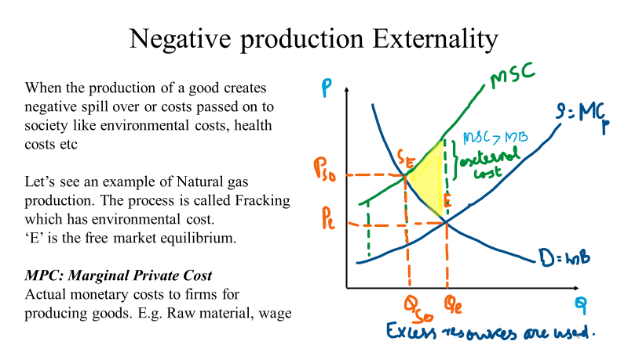

Slide 23
MSC: Marginal Social Cost: These are the cost incurred by society as a whole(including MPC and all external cost)
Qso: Socially optimal quantity of production when all costs are taken into account
Pso: Price of gas if all costs taken into account
DWL: Dead Weight Loss
The yellow triangle represents in loss of total welfare resulted from over production of natural gas.

